Slide 1
Requirements Modeling
By : Arvind Sharma

Slide 2
Topic covered
Requirement modeling
Requirement modeling flow
Requirement modeling behavior
Requirement modeling patterns

Slide 3
Requirements Modeling Strategies
One view of requirements modeling, called structured analysis, considers data and the processes that transform the data as separate entities.
  Data objects are modeled in a way that defines their attributes and relationships.
  Processes that manipulate data objects are modeled in a manner that shows how they transform data as data objects flow through the system.
A second approach to analysis modeled, called object-oriented analysis, focuses on
  the definition of classes and
  the manner in which they collaborate with one another to effect customer requirements.

Slide 4
Flow-Oriented Modeling
Represents how data objects are transformed at they move through the system
data flow diagram (DFD) is the diagrammatic form that is used
Considered by many to be an “old school” approach, but continues to provide a view of the system that is unique—it should be used to supplement other analysis model elements

Slide 5
The Flow Model
Every computer-based system is an
information transform ....
computer
based
system
input
output

Slide 6
Flow Modeling Notation
external entity
process
data flow
data store

Slide 7
External Entity
A producer or consumer of data
Examples: a person, a device, a sensor
Another example: computer-based
system
Data must always originate somewhere
and must always be sent to something

Slide 8
Process
A data transformer (changes input
to output)
Examples: compute taxes, determine area,
format report, display graph
Data must always be processed in some
way to achieve system function

Slide 9
Data Flow
Data flows through a system, beginning
as input and transformed into output.
base
compute
triangle
area
area
height

Slide 10
Data Stores
Data is often stored for later use.
sensor #
sensor #, type,
location, age
look-up
sensor
data
report required
type,
location, age
sensor number
sensor data

Slide 11
Data Flow Diagramming: Guidelines
all icons must be labeled with meaningful names
the DFD evolves through a number of levels of detail
always begin with a context level diagram (also called level 0)
always show external entities at level 0
always label data flow arrows
do not represent procedural logic

Slide 12
Constructing a DFD—I
review user scenarios and/or the data model to isolate data objects and use a grammatical parse to determine “operations”
determine external entities (producers and consumers of data)
create a level 0 DFD

Slide 13
Level 0 DFD Example
processing
request
user
requested
video
signal
digital
video
processor
monitor
video
source
NTSC
video signal

Slide 14
Constructing a DFD—II
write a narrative describing the transform
parse to determine next level transforms
“balance” the flow to maintain data flow continuity
develop a level 1 DFD
use a 1:5 (approx.) expansion ratio

Slide 15
The Data Flow Hierarchy
a
b
x
P
y
level 0
a
c
p2
f
p1
p4
b
d
5
p3
e
g
level 1

Slide 16
Flow Modeling Notes
each bubble is refined until it does just one thing
the expansion ratio decreases as the number of levels increase
most systems require between 3 and 7 levels for an adequate flow model
a single data flow item (arrow) may be expanded as levels increase (data dictionary provides information)

Slide 17
Process Specification (PSPEC)
bubble
PSPEC
narrative
pseudocode (PDL)
equations
tables
diagrams and/or charts

Slide 18
DFDs: A Look Ahead
analysis model
Maps into
design model

Slide 19
Control Flow Modeling
Represents “events” and the processes that manage events
An “event” is a Boolean condition that can be ascertained by:
    listing all sensors that are "read" by the software.
    listing all interrupt conditions.
    listing all "switches" that are actuated by an operator.
    listing all data conditions.
    recalling the noun/verb parse that was applied to the processing narrative, review all "control items" as possible CSPEC inputs/outputs.

Slide 20
Control Specification (CSPEC)
The CSPEC can be:
state diagram
(sequential spec)
state transition table
combinatorial spec
decision tables
activation tables

Slide 21
Behavioral Modeling
The behavioral model indicates how software will respond to external events or stimuli. To create the model, the analyst must perform the following steps:
    Evaluate all use-cases to fully understand the sequence of interaction within the system.
    Identify events that drive the interaction sequence and understand how these events relate to specific objects.
    Create a sequence for each use-case.
    Build a state diagram for the system.
    Review the behavioral model to verify accuracy and consistency.

Slide 22
State Representations
In the context of behavioral modeling, two different characterizations of states must be considered:
  the state of each class as the system performs its function and
  the state of the system as observed from the outside as the system performs its function
The state of a class takes on both passive and active characteristics [CHA93].
  A passive state is simply the current status of all of an object’s attributes.
  The active state of an object indicates the current status of the object as it undergoes a continuing transformation or processing.

Slide 23
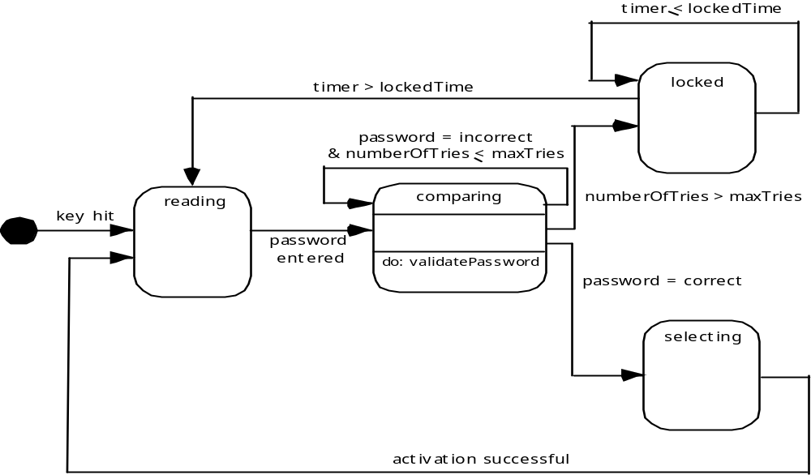
State Diagram for the ControlPanel Class

Slide 24
The States of a System
state—a set of observable circum-stances that characterizes the behavior of a system at a given time
state transition—the movement from one state to another
event—an occurrence that causes the system to exhibit some predictable form of behavior
action—process that occurs as a consequence of making a transition

Slide 25
Behavioral Modeling
make a list of the different states of a system (How does the system behave?)
indicate how the system makes a transition from one state to another (How does the system change state?)
  indicate event
  indicate action
draw a state diagram or a sequence diagram

Slide 26
Writing the Software Specification
Everyone knew exactly what had to be done until someone wrote it down!

Slide 27
Patterns for Requirements Modeling
Software patterns are a mechanism for capturing domain knowledge in a way that allows it to be reapplied when a new problem is encountered
  domain knowledge can be applied to a new problem within the same application domain
  the domain knowledge captured by a pattern can be applied by analogy to a completely different application domain.

Slide 28
Discovering Analysis Patterns
The most basic element in the description of a requirements model is the use case.
A coherent set of use cases may serve as the basis for discovering one or more analysis patterns.
A semantic analysis pattern (SAP) “is a pattern that describes a small set of coherent use cases that together describe a basic generic application.

Slide 29
An Example
Consider the following preliminary use case for software required to control and monitor a real-view camera and proximity sensor for an automobile:
    Use case: Monitor reverse motion
    Description: When the vehicle is placed in reverse gear, the control software enables a video feed from a rear-placed video camera to the dashboard display. The control software superimposes a variety of distance and orientation lines on the dashboard display so that the vehicle operator can maintain orientation as the vehicle moves in reverse. The control software also monitors a proximity sensor to determine whether an object is inside 10 feet of the rear of the vehicle. It will automatically break the vehicle if the proximity sensor indicates an object within 3 feet of the rear of the vehicle.

Slide 30
An Example
This use case implies a variety of functionality that would be refined and elaborated (into a coherent set of use cases) during requirements gathering and modeling.
Regardless of how much elaboration is accomplished, the use case(s) suggest(s) a simple, yet widely applicable SAP—the software-based monitoring and control of sensors and actuators in a physical system.
In this case, the “sensors” provide information about proximity and video information. The “actuator” is the breaking system of the vehicle (invoked if an object is very close to the vehicle.
But in a more general case, a widely applicable pattern is discovered --> Actuator-Sensor

Slide 31
Actuator-Sensor Pattern—I
Pattern Name: Actuator-Sensor
Intent: Specify various kinds of sensors and actuators in an embedded system.
Motivation: Embedded systems usually have various kinds of sensors and actuators. These sensors and actuators are all either directly or indirectly connected to a control unit. Although many of the sensors and actuators look quite different, their behavior is similar enough to structure them into a pattern. The pattern shows how to specify the sensors and actuators for a system, including attributes and operations. The Actuator-Sensor pattern uses a pull mechanism (explicit request for information) for PassiveSensors and a push mechanism (broadcast of information) for the ActiveSensors.
Constraints:
Each passive sensor must have some method to read sensor input and attributes that represent the sensor value.
Each active sensor must have capabilities to broadcast update messages when its value changes.
Each active sensor should send a life tick, a status message issued within a specified time frame, to detect malfunctions.
Each actuator must have some method to invoke the appropriate response determined by the ComputingComponent.
Each sensor and actuator should have a function implemented to check its own operation state.
Each sensor and actuator should be able to test the validity of the values received or sent and set its operation state if the values are outside of the specifications.

Slide 32
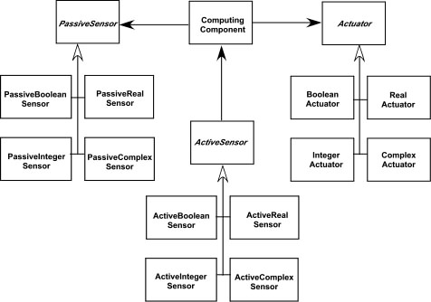
Actuator-Sensor Pattern—II
Applicability: Useful in any system in which multiple sensors and actuators are present.
Structure: A UML class diagram for the Actuator-Sensor Pattern is shown in Figure 7.8. Actuator, PassiveSensor and ActiveSensor are abstract classes and denoted in italics. There are four different types of sensors and actuators in this pattern. The Boolean, integer, and real classes represent the most common types of sensors and actuators. The complex classes are sensors or actuators that use values that cannot be easily represented in terms of primitive data types, such as a radar device. Nonetheless, these devices should still inherit the interface from the abstract classes since they should have basic functionalities such as querying the operation states.

Slide 33
Actuator-Sensor Pattern—III
Behavior: presents a UML sequence diagram for an example of the Actuator-Sensor Pattern as it might be applied for the SafeHome function that controls the positioning (e.g., pan, zoom) of a security camera. Here, the ControlPanel queries a sensor (a passive position sensor) and an actuator (pan control) to check the operation state for diagnostic purposes before reading or setting a value. The messages Set Physical Value and Get Physical Value are not messages between objects. Instead, they describe the interaction between the physical devices of the system and their software counterparts. In the lower part of the diagram, below the horizontal line, the PositionSensor reports that the operation state is zero. The ComputingComponent then sends the error code for a position sensor failure to the FaultHandler that will decide how this error affects the system and what actions are required. it gets the data from the sensors and computes the required response for the actuators.

Slide 34
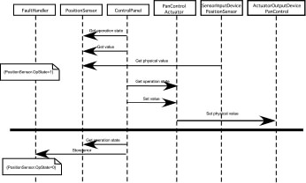
Actuator-Sensor Pattern—III

